Slide 1

Office Supplies Analysis by Fyneface Ndubuisi

Slide 2
Project Overview & Business Goals
Pens & Printers office supply chain Company sends stocks up same products in four of their warehouse located in East, West, South and Central Region. This leads to a lot of unsold products in these warehouse locations or stocking products that do not sell well in some of these locations.
v
Management wants to know which products didn’t yield profit for the company in each of the warehouse from 2014 to 2017 and find out if there is a trend or pattern associated with the products and warehouse locations.
Lastly provide recommendations on what categories of products will be needed more in each warehouse so as to maximize profit and reduce loss to the barest minimum in each warehouse in coming years.

Slide 3
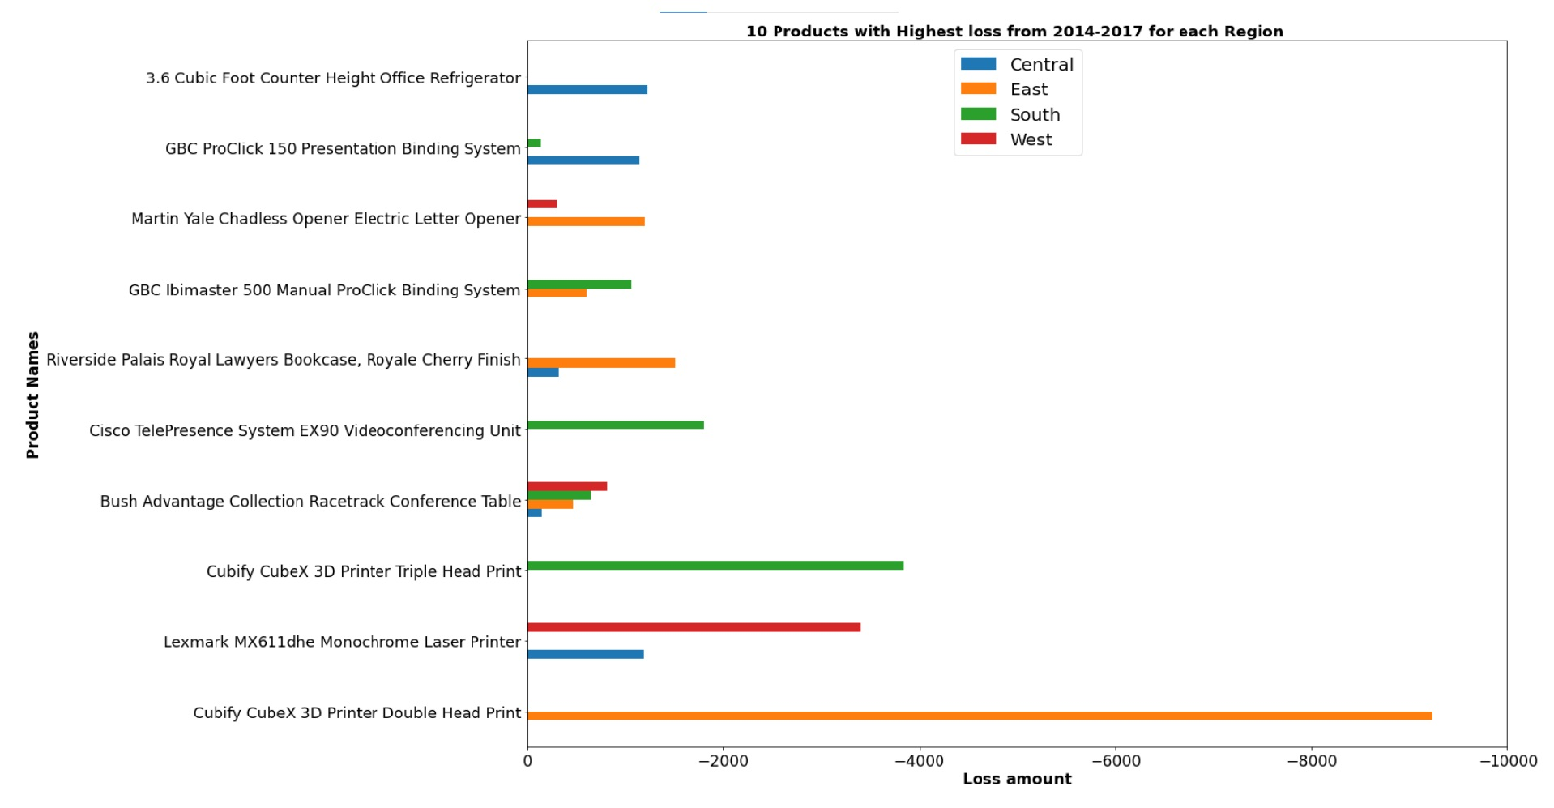
KEY FINDINGS

Slide 4
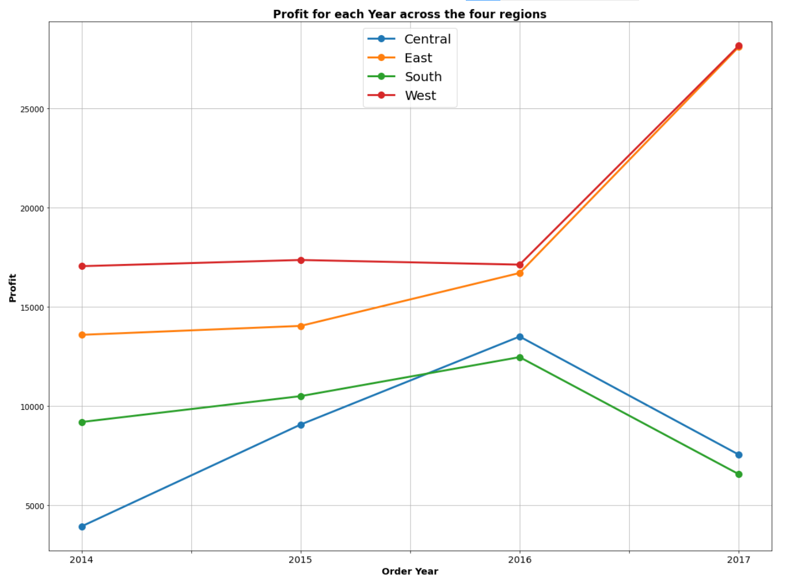
KEY FINDINGS
We are interested more in the recall score. It needs to maximized while also decreasing False Negatives

Slide 5
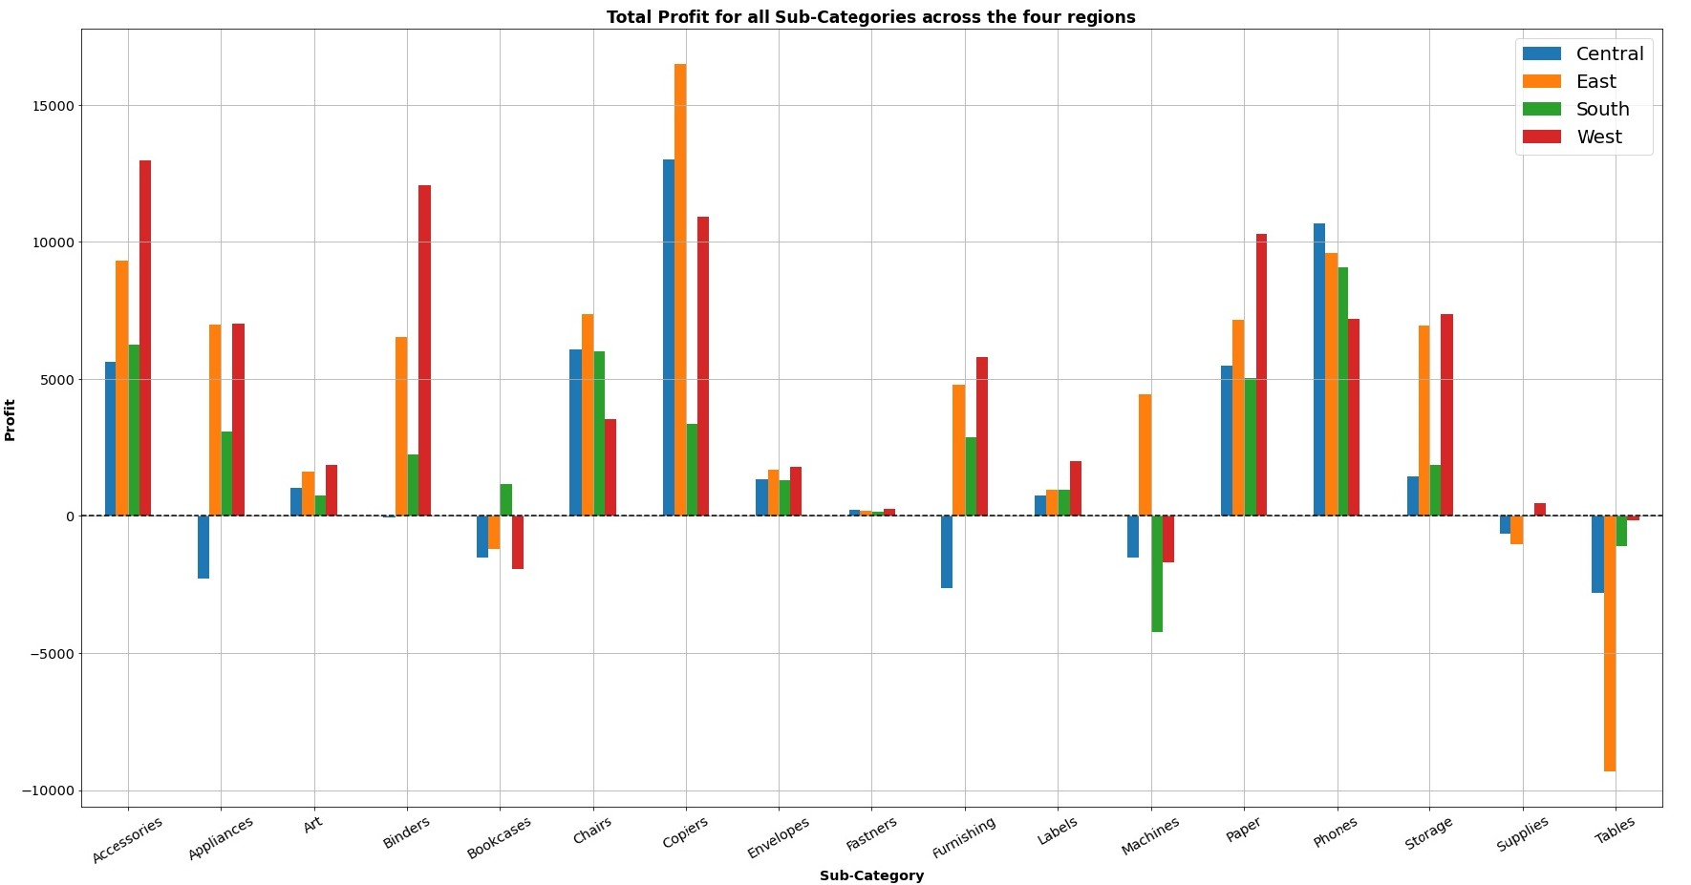
KEY FINDINGS

Slide 6
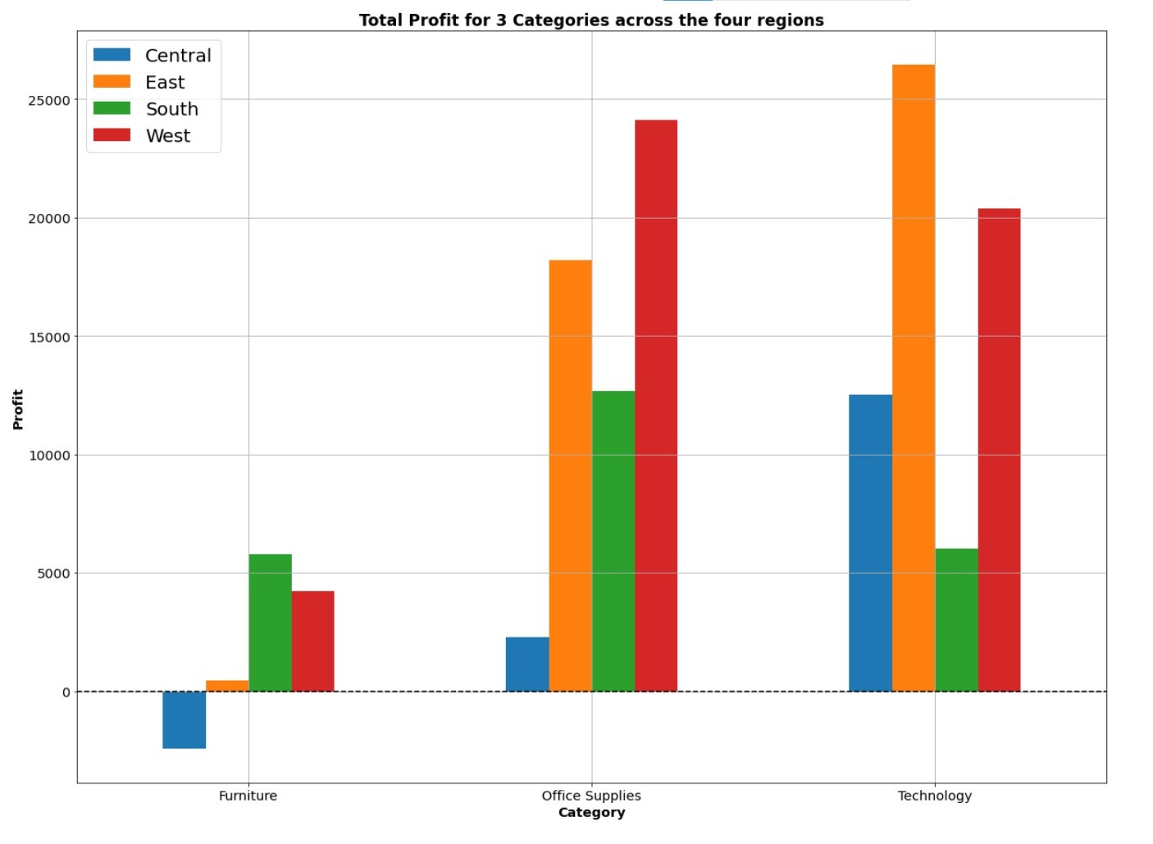
KEY FINDINGS
SOLUTION APPROACH cont’d

Slide 7
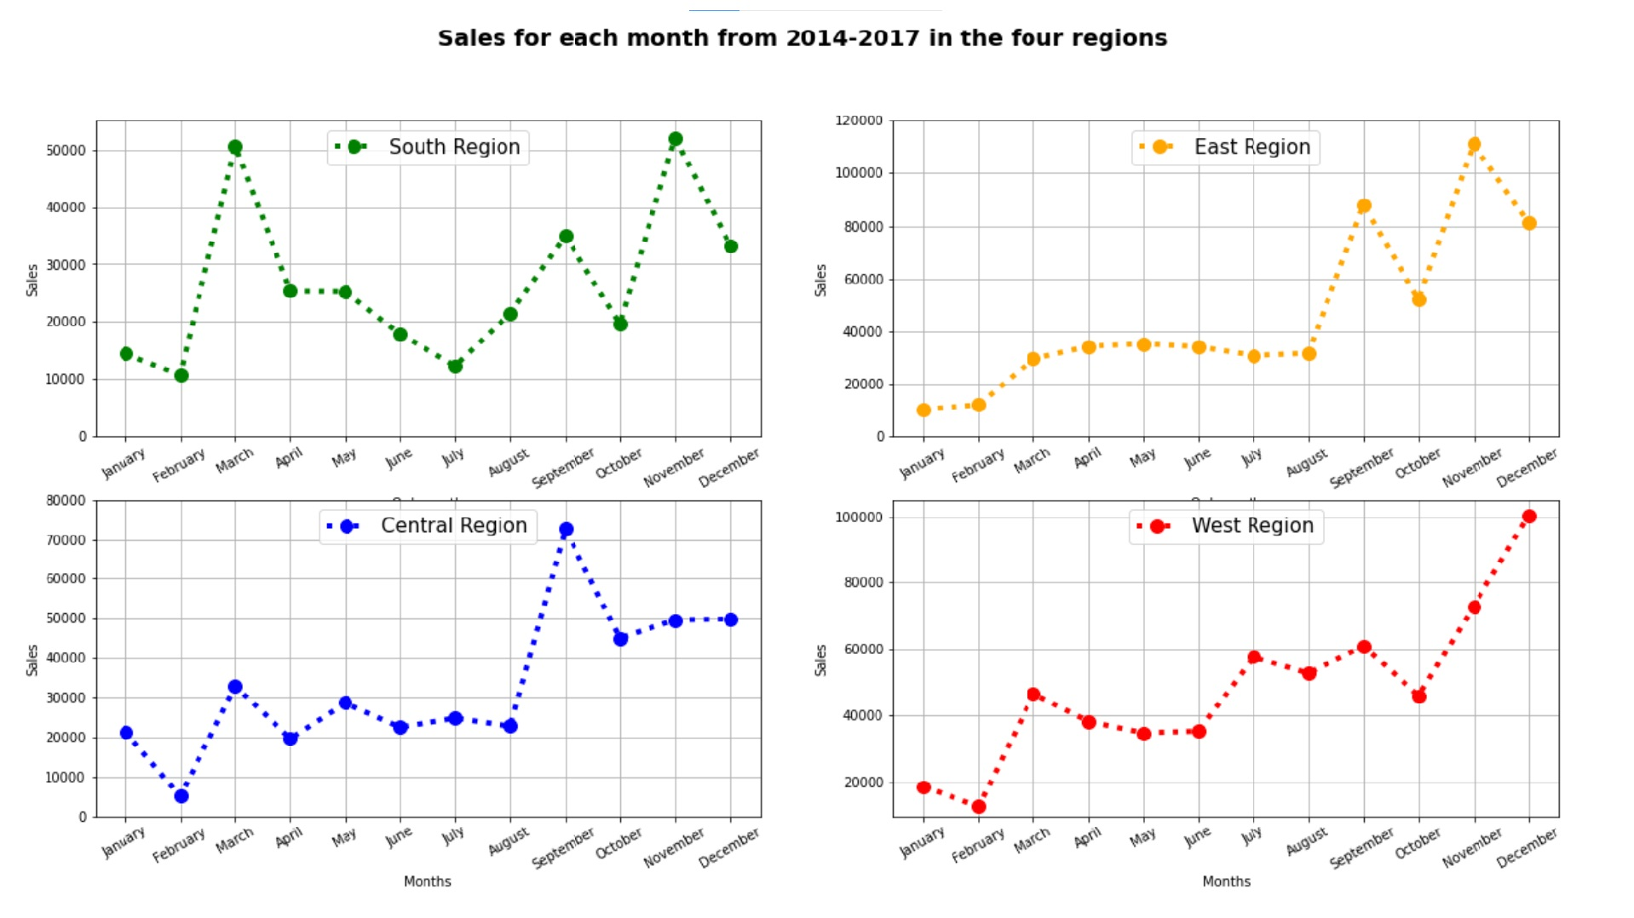
KEY FINDINGS
THANK YOU !

Slide 8
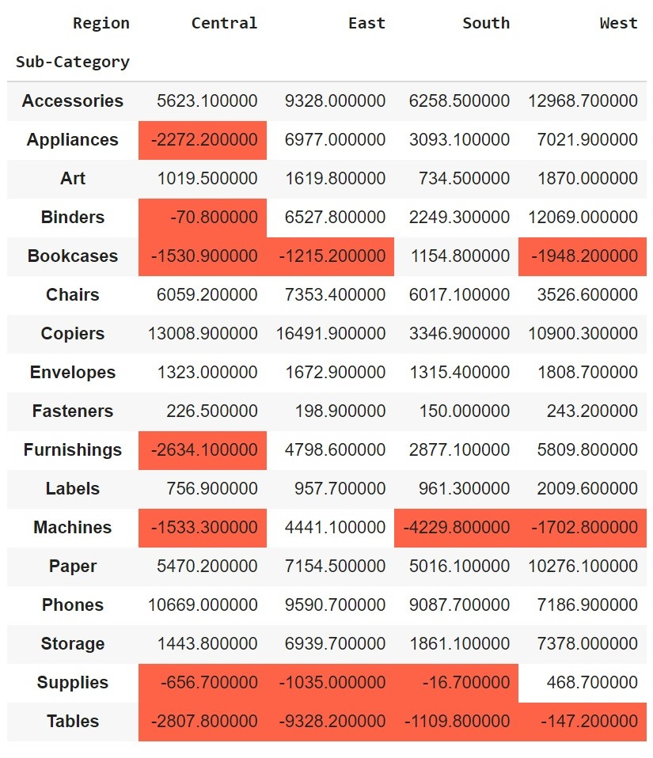
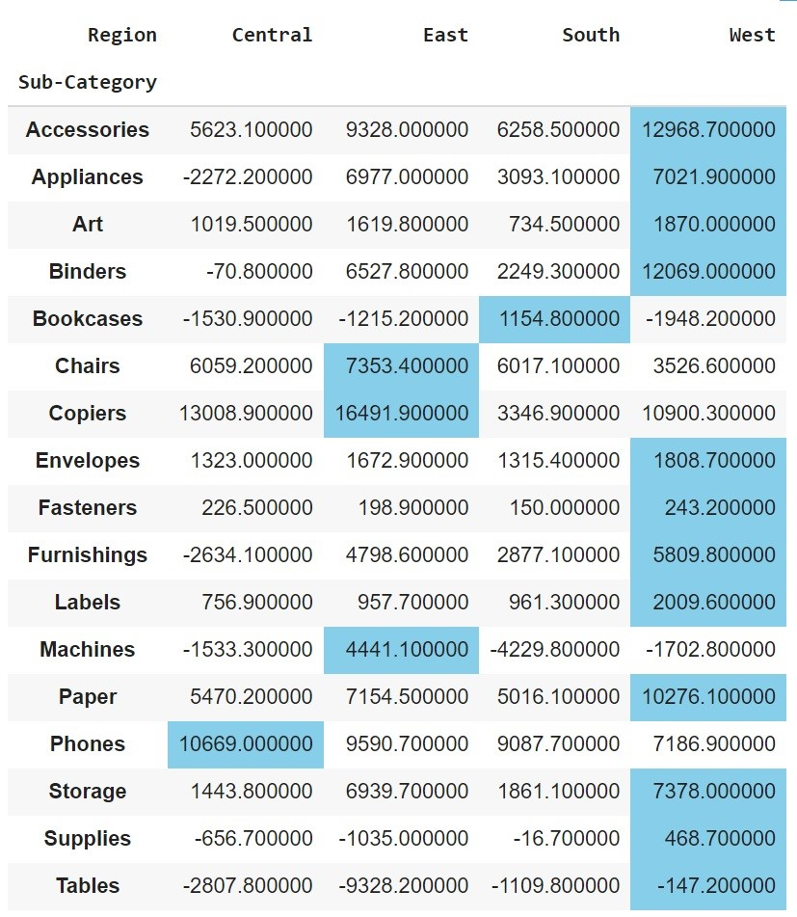
Recommendations
South should stock up more of bookcases, phones, paper, chairs, copiers, accessories and less machines, tables and supplies.
Loss
Most Gain
v
East should focus more on appliances, accessories, copiers, envelopes, machines, storage, chairs, furnishing, labels, paper, art. Reducing stocking Tables, bookcases and supplies
West warehouse should have all subcategories but less quantity of Machines, Bookcases and Tables
Central warehouse should stock up more of phones, chairs, copiers, accessories and less machines, , tables, supplies, bookcases, appliances, binders, furnishing

